Slide 1
What are Common traits of car Insurance Fraud?
GROUP 5
Braden Christer
Nick Fuller
Tvisha Goswami
Abhishek Nambiar

Slide 2
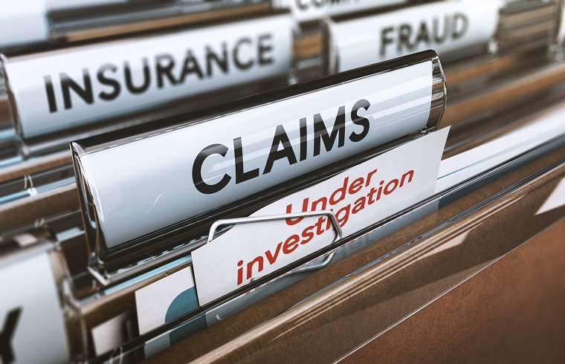
Introduction
According to Insurance Information Institute¹: Auto insurers in the US lose at least $29 billion a year to Insurance Fraud
Multiple studies have researched the applicability of statistical methods to meaningfully predict frauds before they occur
Using data analysis and visualizations, we try to analyze relationships between several claim-related factors and their ability to predict frauds based on large dataset

Slide 3
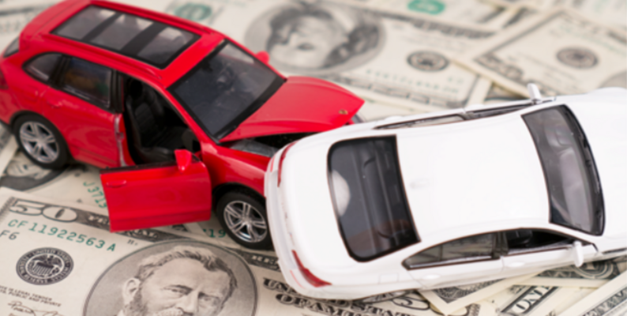
The data
Insurance Fraud incidents from accident data taken from Kaggle
The data had 15,420 entries with 33 unique attributes
The accident data took place from Jan 1994 – Dec 1996

Slide 4
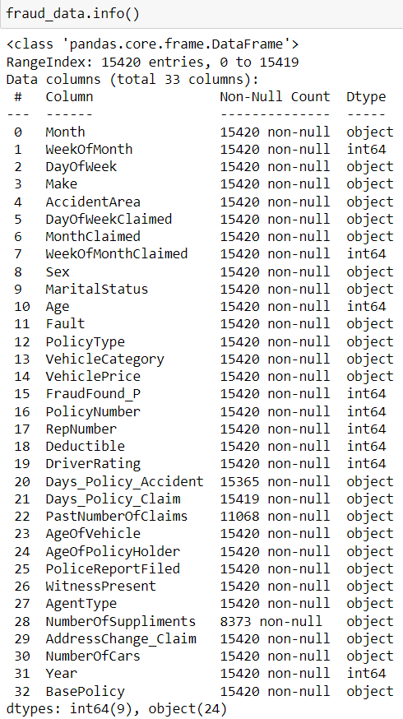
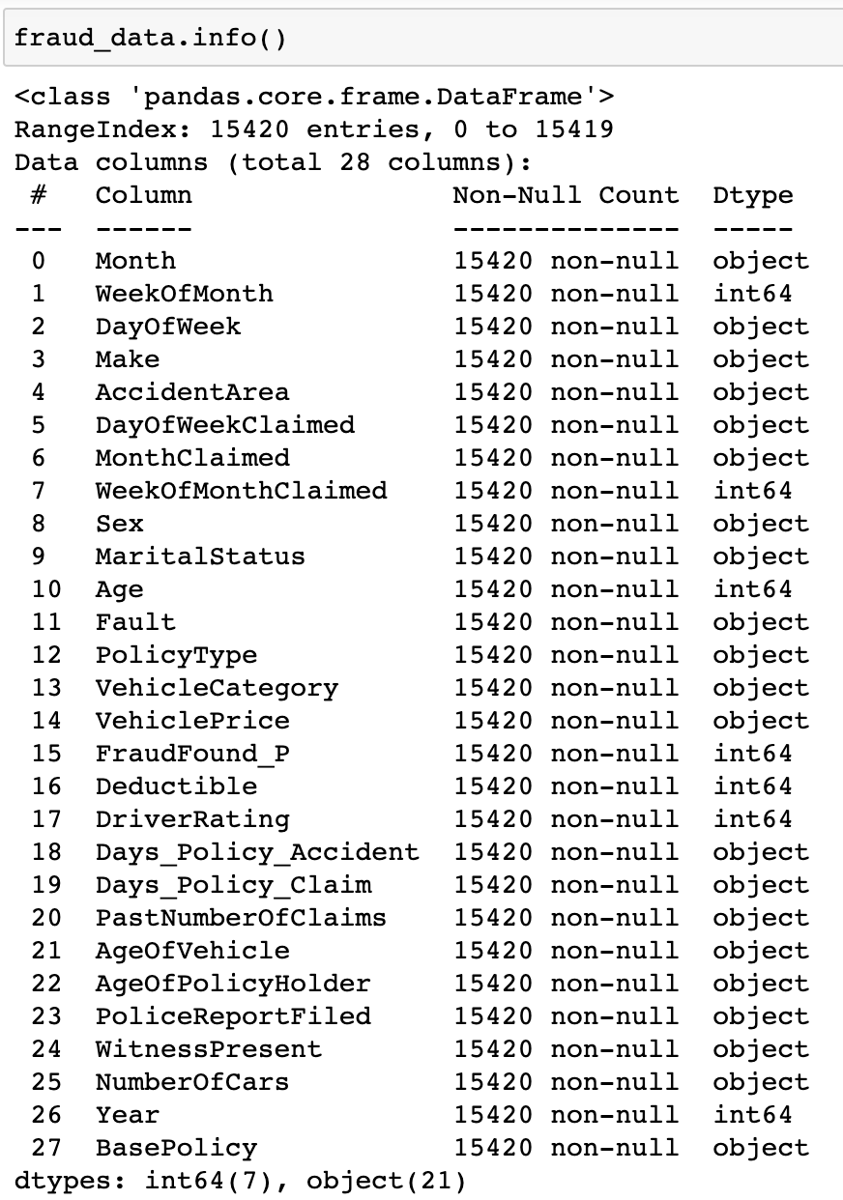
Factors Under Consideration
All Available Factors
Factors used in the Analysis
We filter down the available list of factors based on literature review. Factors which have been good predictors of fraud in past research are retained for the analysis
Notes:
The highlighted variables are ones we used in the analysis

Slide 5
Data cleaning
Within the dataset, a person’s age appeared to be 0
This was interpreted to be an N/A value and thus removed from the data
The column “NumberOfSuppliments” had NaN values, but this attribute was not used in the analysis
After cleaning, only 320 entries were removed (2.07% of the total data)
There were no duplicate entries or any N/A entries
 | # of Observations | # of Observations with Age = 0
Before Cleaning Age | 15,420 | 320
Removing Obs. With Age = 0 | 15,100 | 0

Slide 6
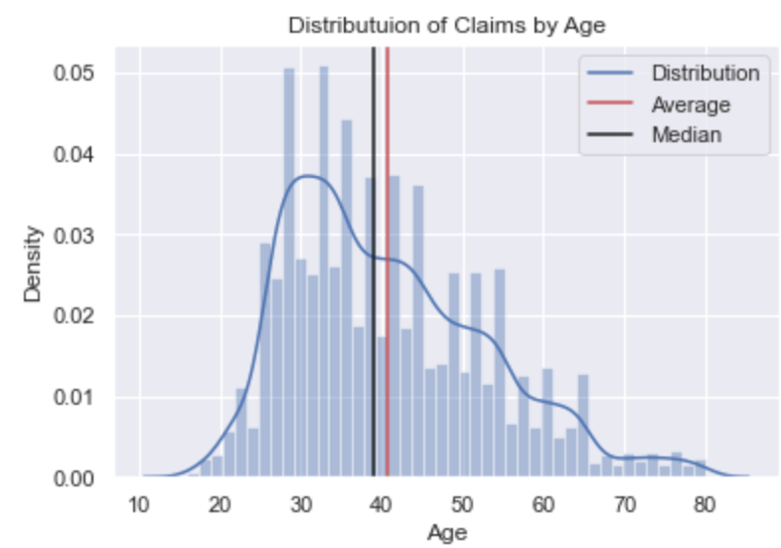
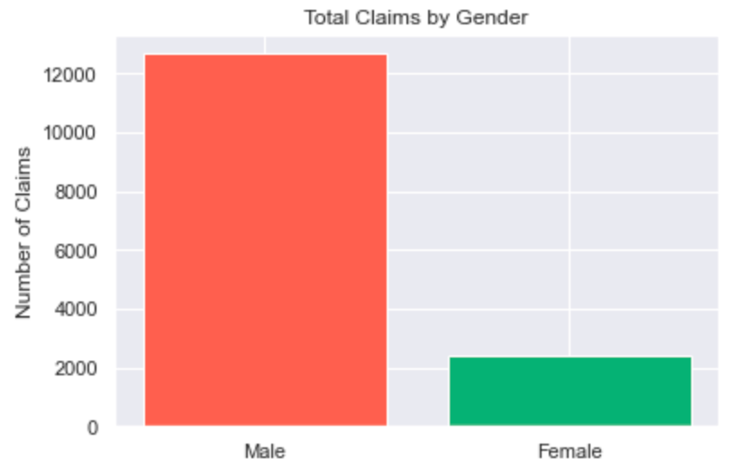
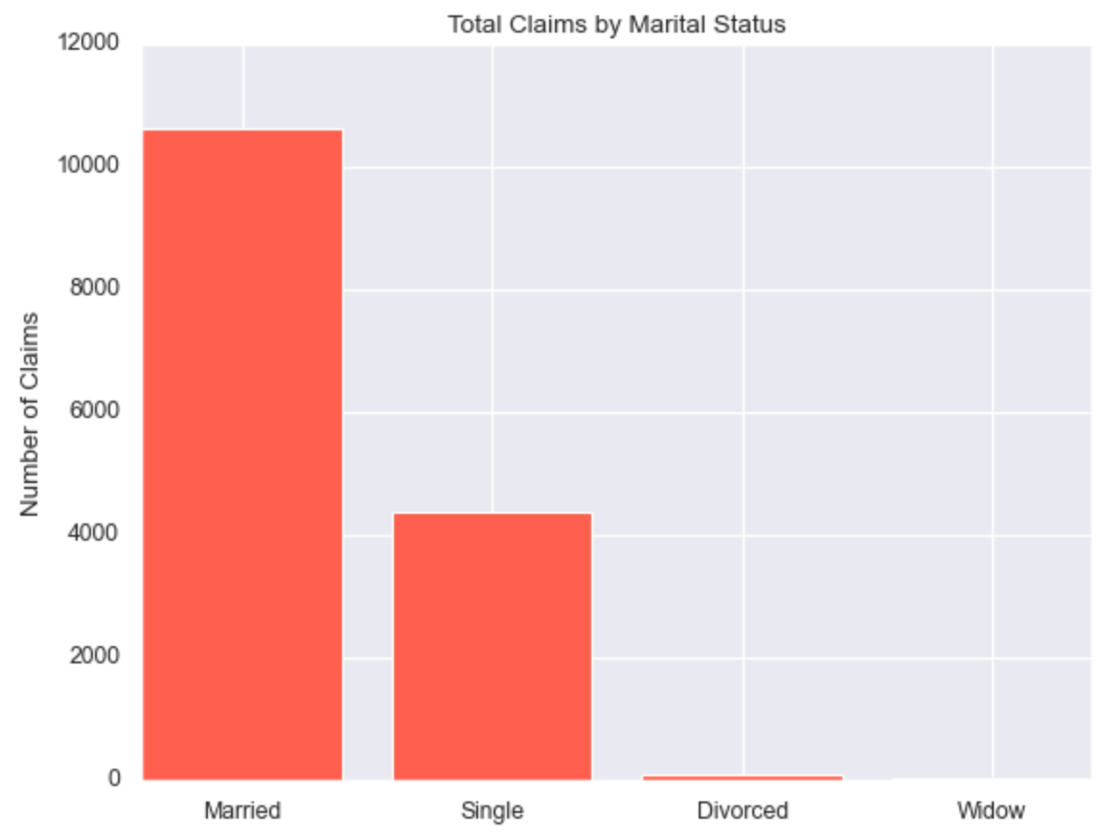
General Characteristics of the data
Data shows that most claims on auto insurance are made by adults over the age of 30
Average age of insurance claimers is ~ 40
Historically, males and married sections of the demographic have made most of the claims

Slide 7
Questions to consider
Who is more likely to commit fraud, males or females?
What make of vehicle had the highest amount of fraud cases?
What age and age range has the highest proportion for fraud?
What type of relationship status (Single, Married, Divorced, Widow) has a higher proportion for fraud?
What policy type is most prevalent in fraud claims?
Where do fraudulent incidents occur?
How old are the vehicles involved in fraud claims?
How expensive are the vehicles in fraud cases?
What type of person commits the most fraud?

Slide 8
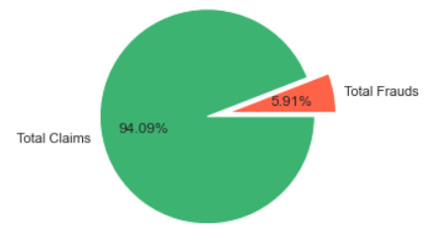
Amount of fraud present in the data
Of the 15,100 accident claims, 892 were found to be fraudulent
Notes:
Our focus is only on ~6% of the data meaning that our analysis just became much smaller for the cases we are considering

Slide 9

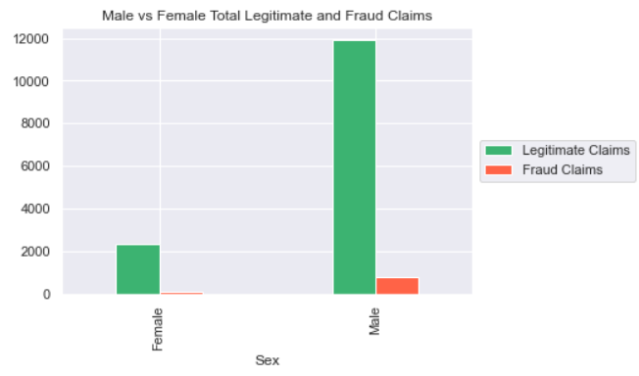
Male vs female fraud cases
The total claims for males: 12,680
The total claims for females: 2,420
The total fraudulent claims for males: 787
The total fraudulent claims for females: 105
Notes:
Of the total cases, 6.2% of males committed fraud and 4.33% of females committed fraud

Slide 10
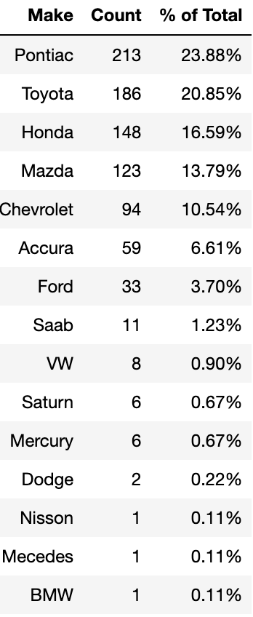
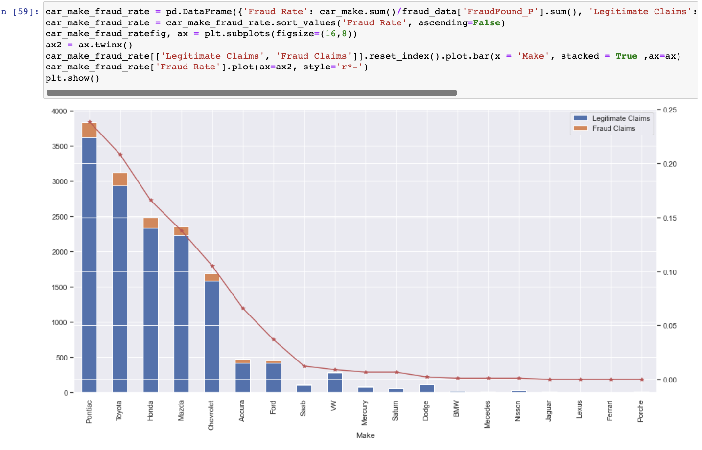
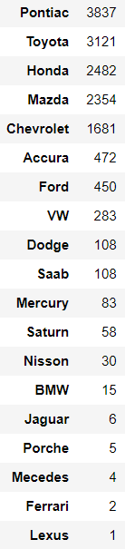
Total Claims based on Vehicle Make

Slide 11
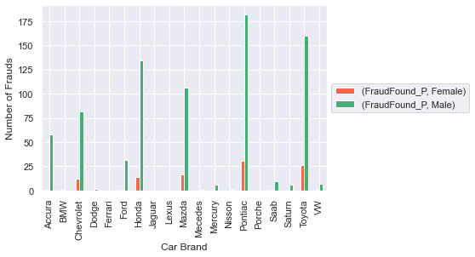
Amount of Fraud Cases with respect to Vehicle Make and Gender

Slide 12
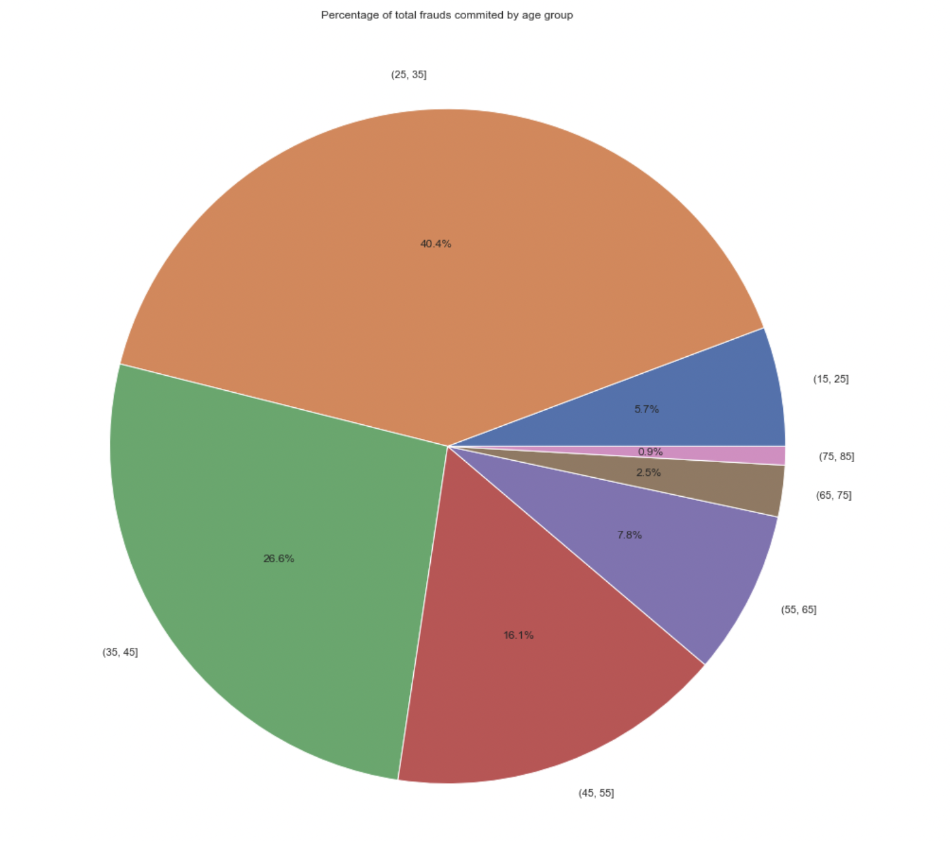
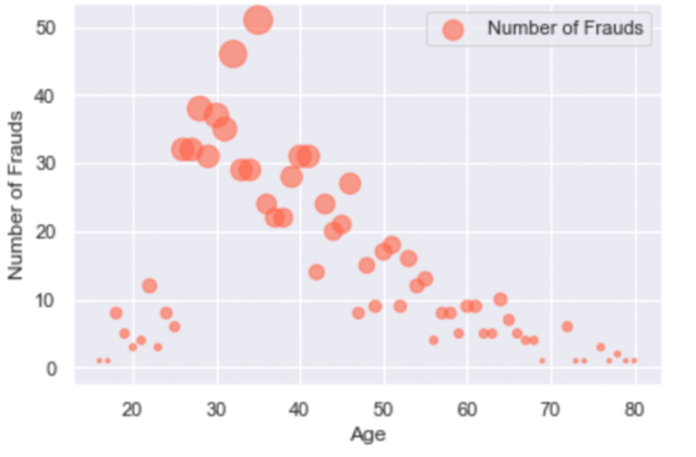
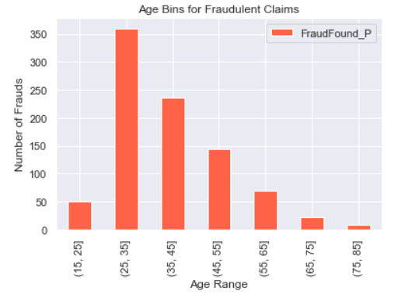
Age with the highest fraud Claims
Fraud spikes after 25 years old, then gradually goes down as age increases
People who are 30 have the highest number of claims filed

Slide 13
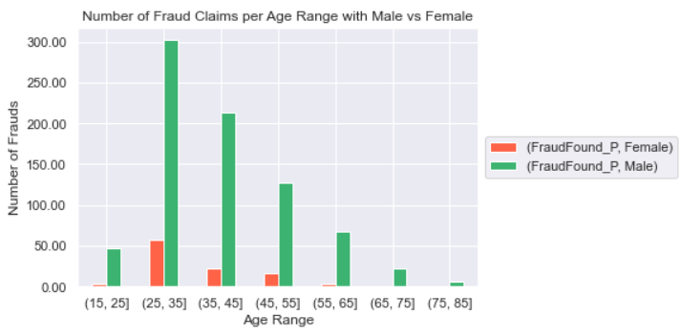
Age range and gender fraud claims
Notes:
We again see a similar graph as before

Slide 14
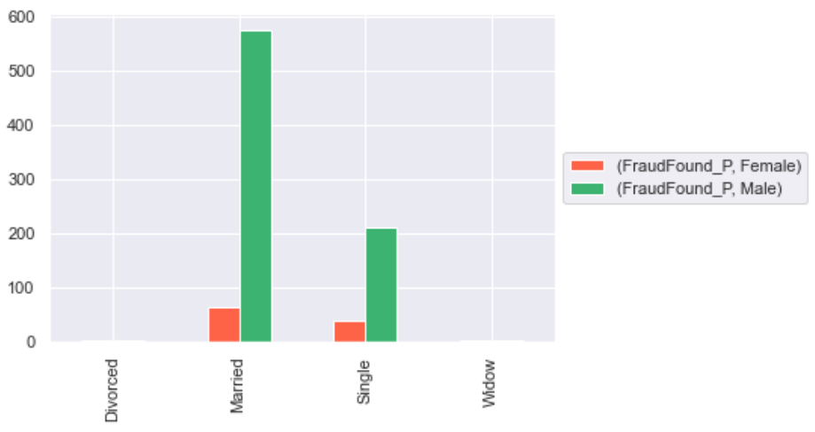
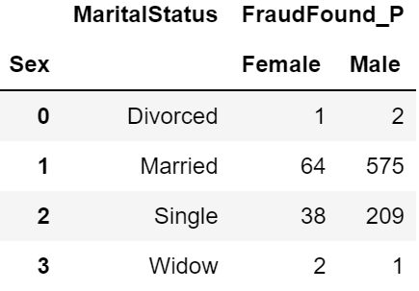
Amount of fraud claims based on marital status and gender
Notes:
Married Men commit the most fraud
This follows what we would expect for a given population where most adults are married, then single

Slide 15
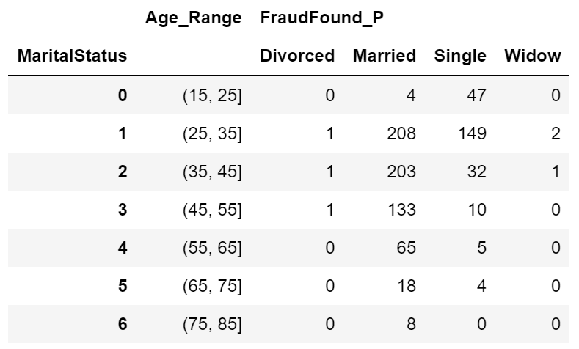
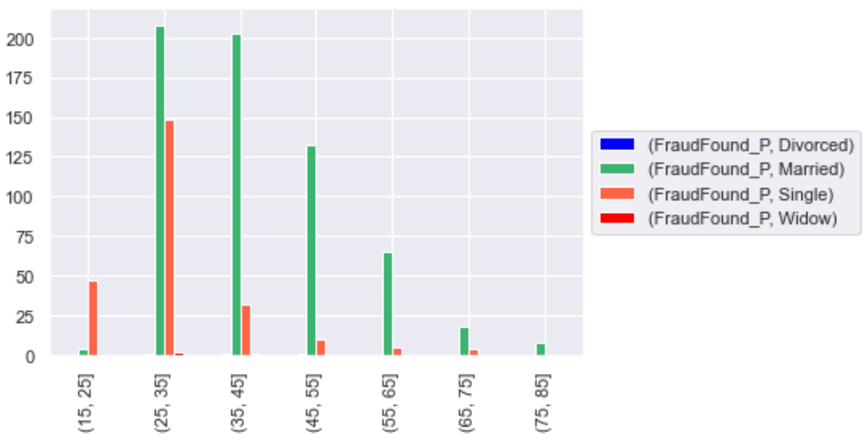

Amount of fraud based on marital status and age
Fraud is committed predominantly by married people between 25 and 45 years of age
Notes:
Fraud is committed predominantly by married people between 25 and 45 years of age

Slide 16
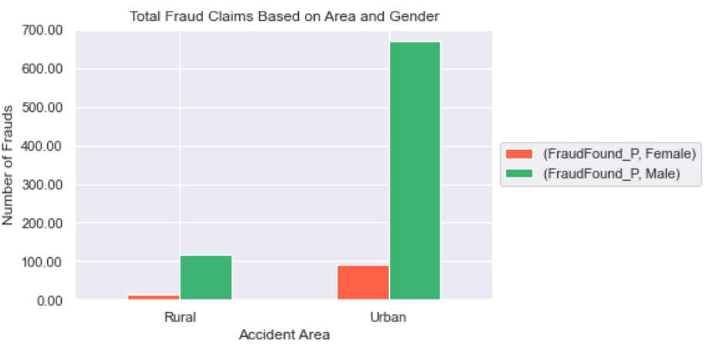
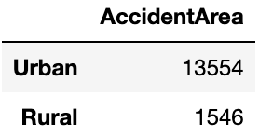
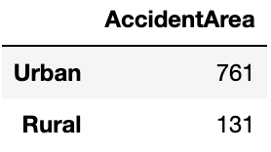
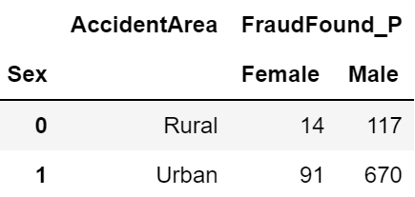
Where does fraud occur?
Total Claims
Total Fraud Claims
Total Fraud Claims with Gender
Most frauds happen in urban areas where the population is higher, and traffic accidents are more severe.
Notes:
Most accidents happen in urban areas where the population is higher, and traffic is more severe.
Something to note is that suburban could be included in metropolitan areas which would be considered in the urban category
If suburban was a category, we would expect it to equalize the distribution, so it isn’t so skewed towards urban

Slide 17
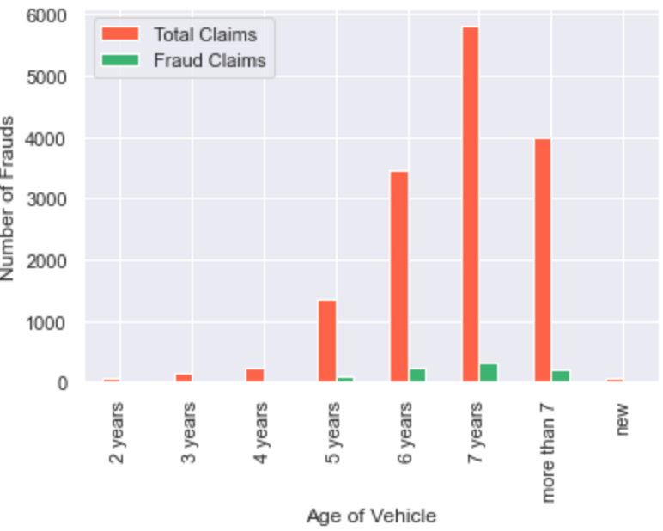
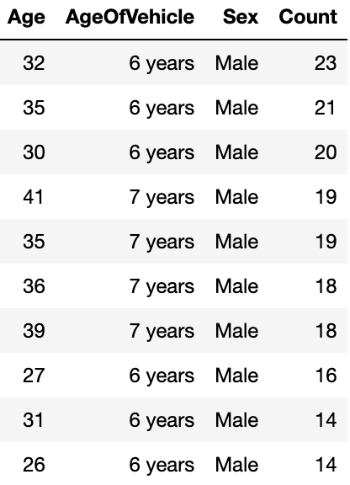
How old are the vehicles in fraud cases?
As the vehicle age increases, a car insurance fraud becomes more likely

Slide 18
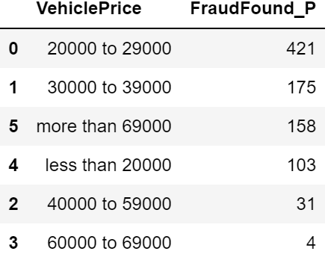
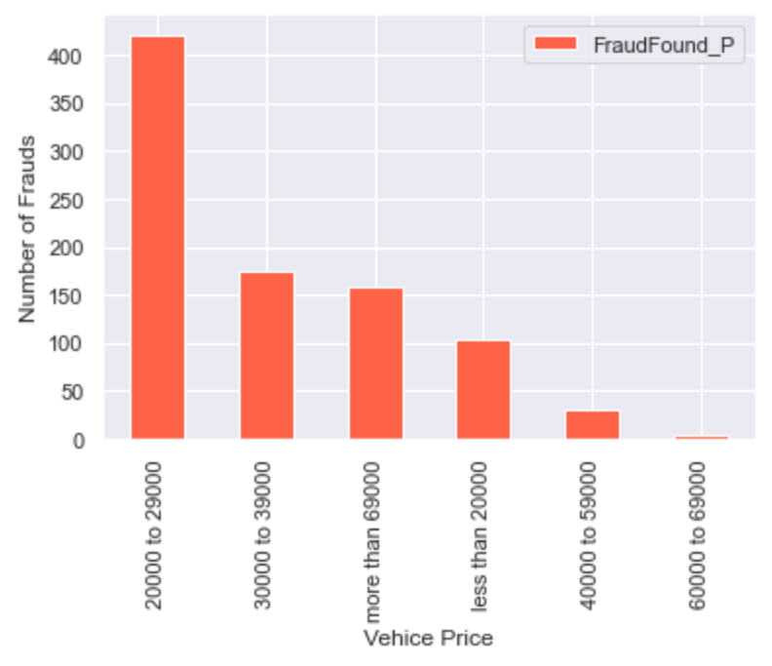
Price of vehicles in fraud claims
It is more likely for owners to commit frauds if their vehicle value is low

Slide 19
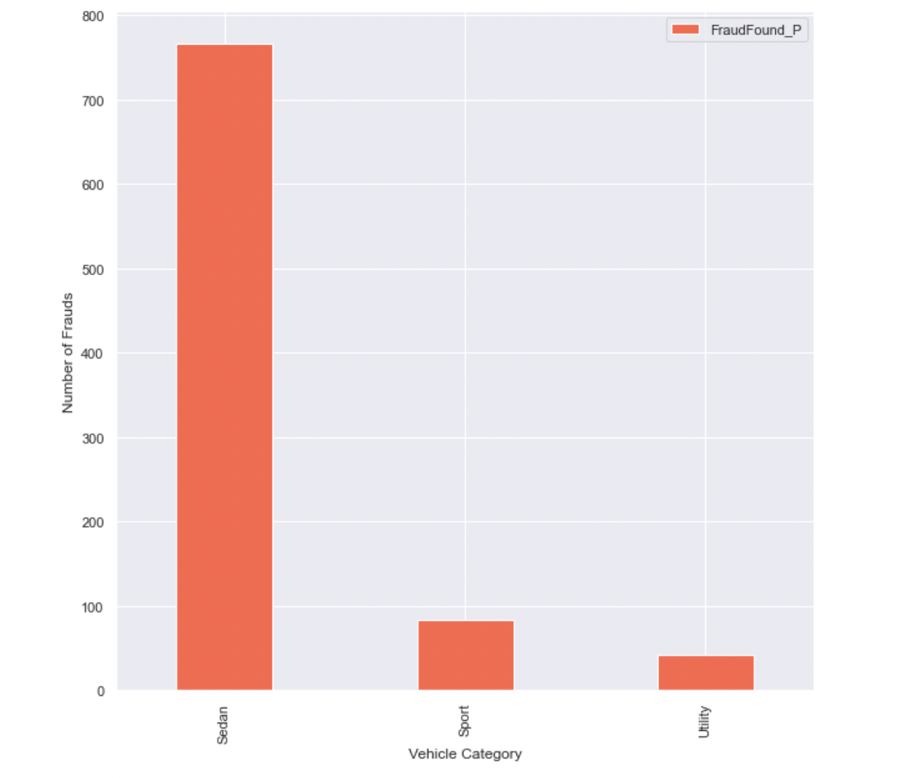
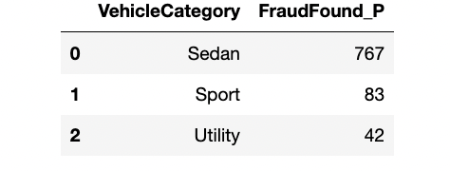
Type of vehicles in fraud claims
It is more likely for owners of Sedans to commit frauds

Slide 20
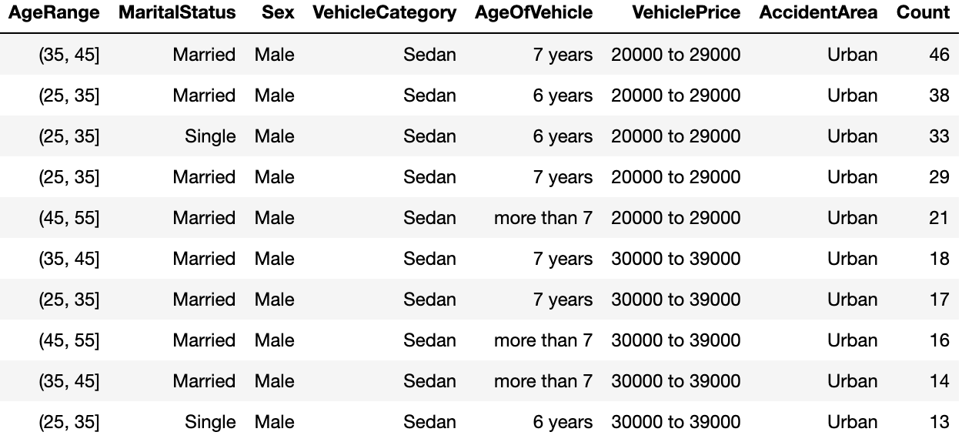
Building a profile for fraud claims
Notes:
We can infer that males between the age of 25 and 45, who own a vehicle that is 6 or more years in age, married, and live in an urban area pose a greater risk for committing insurance fraud.

Slide 21
Business insights
Insurance companies should use the profile we developed to hedge the risk associated with a given policy holder.
Insurance companies can raise premiums on people fitting this profile to reduce financial risk and protect the bottom line.
Insurance ads can be targeted towards certain demographics of the population where higher fraud rates are detected

Slide 22
Appendix

Slide 23
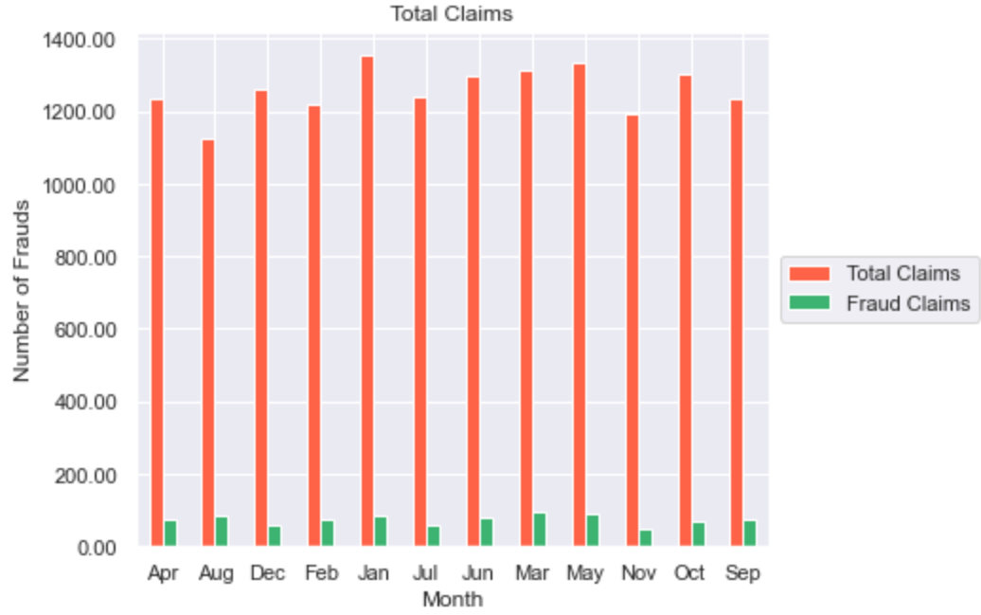
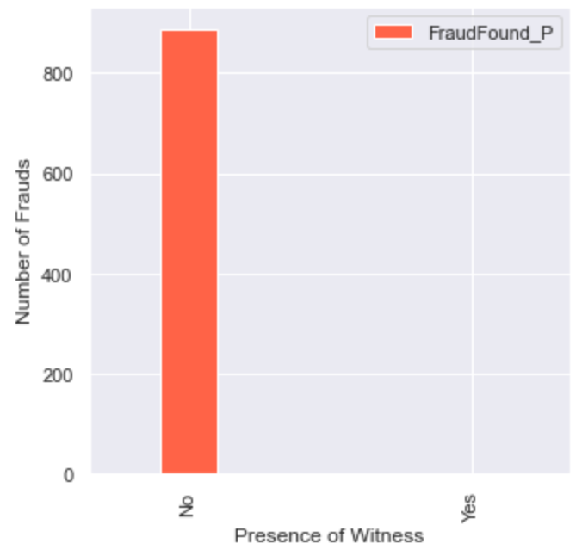
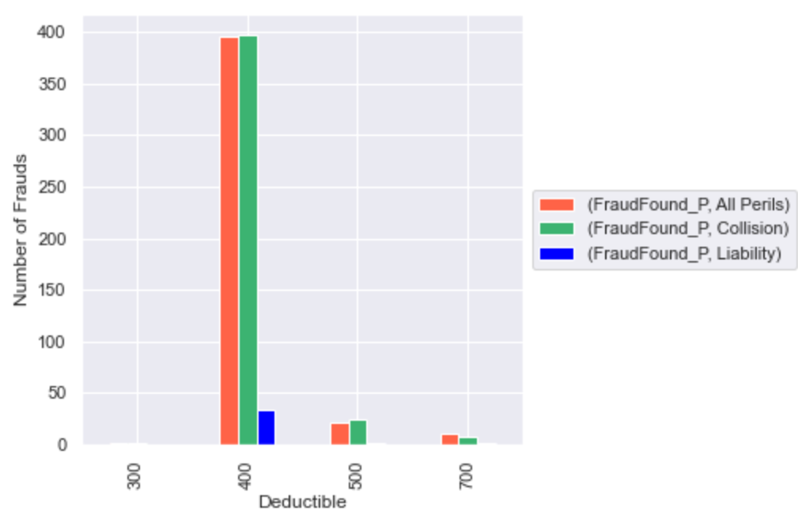
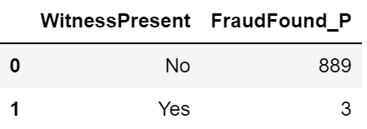
Other data examined but determined to be not insightful
Notes:
The amount of claims in each month is consistent and does not vary significantly between each month, it is not clear to determine a definitive trend or relation between month claimed and number of claims.
Witness presence was not insightful either as it is obvious that with no witnesses present, making a fraudulent claim becomes easier
Finally, deductible amount was not useful either as 400 was the most common deductible amount and not an indicator for fraud.

Slide 24
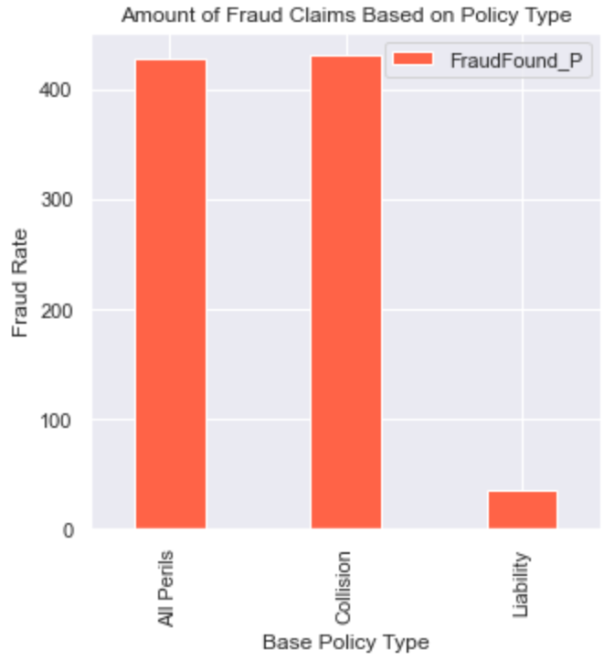
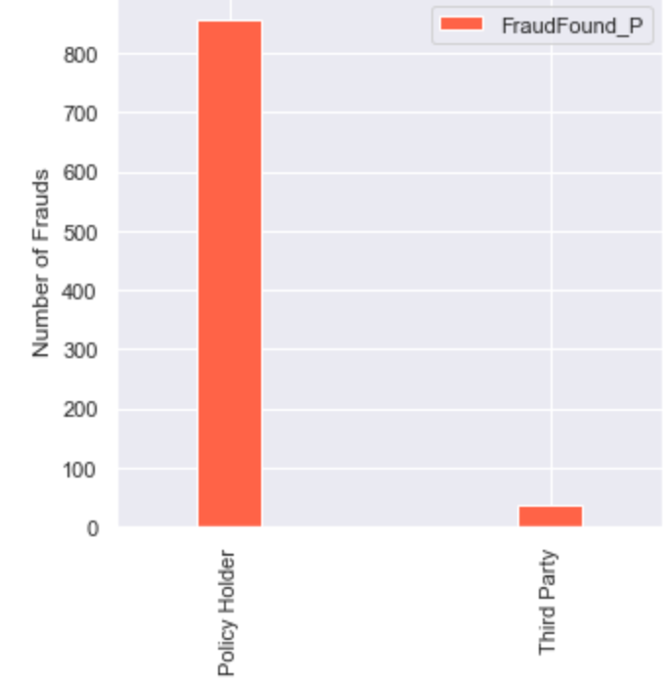
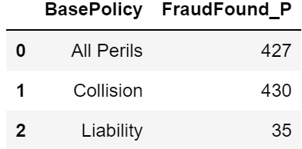
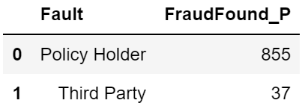
Other data examined but determined to be not insightful (cont.)
Notes:
Here policy type isn’t insightful either as it is obvious that everyone has a baseline coverage for accident claims
Liability does not cover the damages done to your vehicle so it doesn’t make sense for someone to commit fraud with this type of claim as they will gain nothing for their damages.

